Slide 1
Mohammed Zeeshan Ali
Shreya Chauhan
Yachen Chang
Shivangi Bhavsar
Phase 3 - The Prediction
Team 1

Slide 2
Attributes Used In Phase 2
MOHAMMED ZEESHAN ALI
Customer Age
Dependent Count
Income Category
Card Category
Months on Book
Total Relationship Count
Months Inactive 12 mon
Contracts count 12 mon
Credit Limit
Total Revolving Balance
Avg Utilisation Ratio
Total Ct Chng Q4 Q1
Total Trans Ct
Total Trans Amt
Total Amt Chng Q4 Q1

Slide 3
Tested Models
MOHAMMED ZEESHAN ALI
Decision Tree
Gradient Boosted Tree
Deep Learning
Neural Net

Slide 4
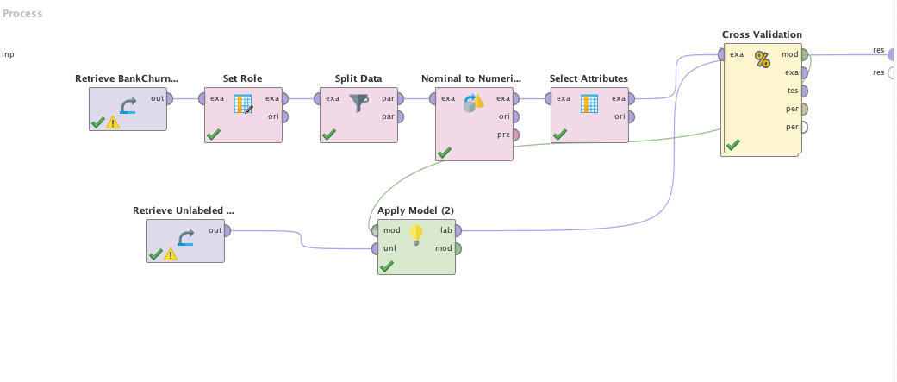
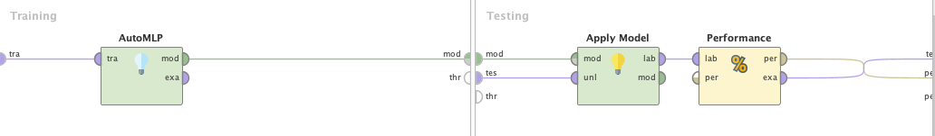
MOHAMMED ZEESHAN ALI
Deep Learning
The Deep learning model with phase 2 suggested attributes is used for prediction
The training and testing is split into 70-30 ratio for prediction of the value.
The ‘Nominal To Numeric’ is used in case of AUTOMLP for conversion of polynomial values.

Slide 5
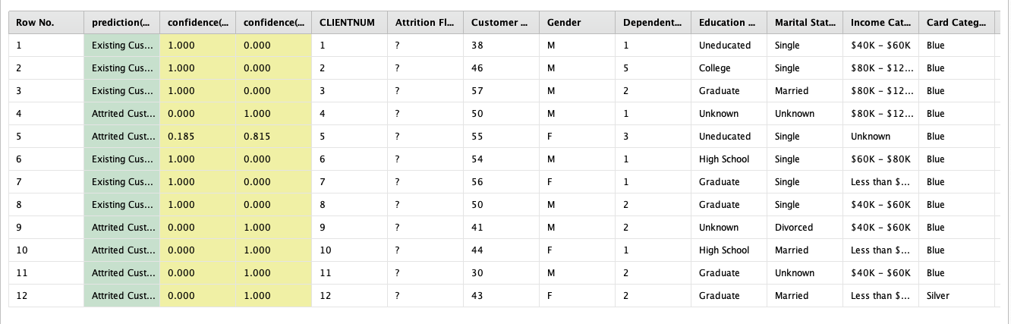
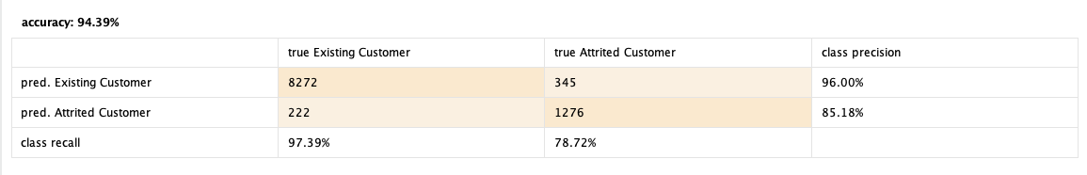
MOHAMMED ZEESHAN ALI
The 50/50 ratio is achieved for Deep Learning (MLP)
The attributes selected could contradict the right prediction
The performance accuracy achieved is 94.39% for Deep Learning.

Slide 6
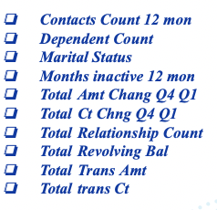
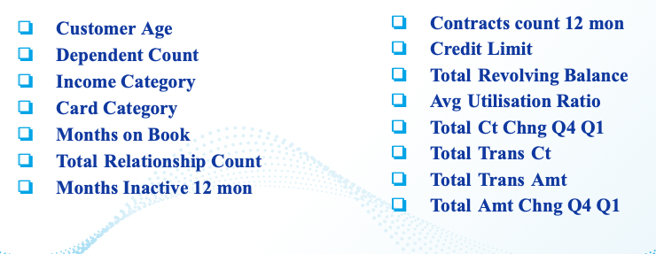
MOHAMMED ZEESHAN ALI
Selection of Attributes

Slide 7
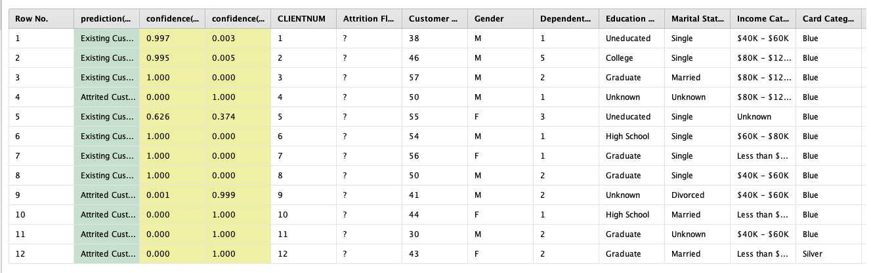
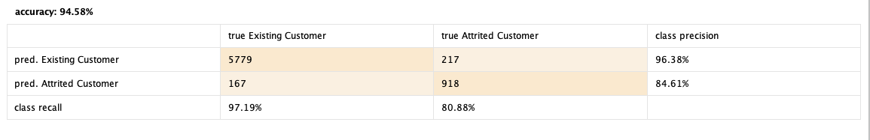
MOHAMMED ZEESHAN ALI
After the adjustment of the attributes the ratio is changed significantly
The Ratio of 5/12 is not providing us with prediction of customers
Another model for prediction needs to be trained since the ratio is not achieved

Slide 8
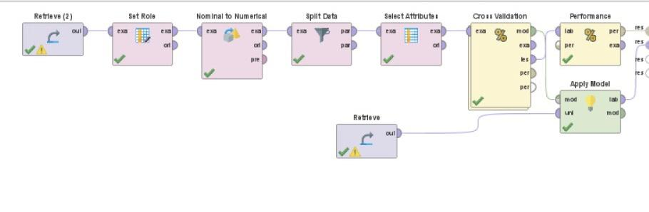
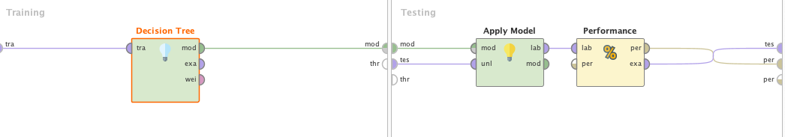
Yachen Chang
Decision Tree
Split the testing and training data into 70/30 ratio

Slide 9
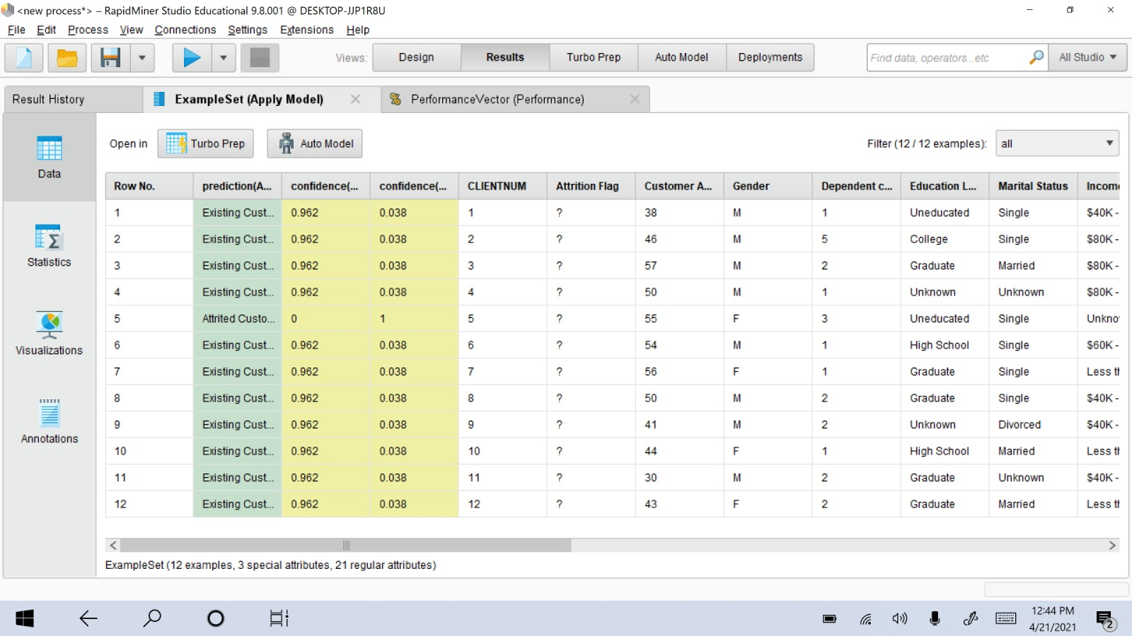
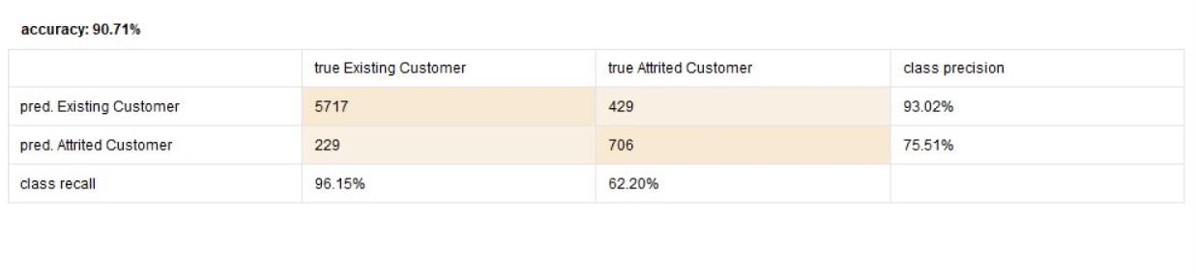
Yachen Chang
Got 1/12 in the result
The performance accuracy is 90.71% for “Decision Tree”.

Slide 10
Attributes Selection,
Shivangi Bhavsar
In phase 3 of project , to test the model chosen from phase 2, following attributed were adjusted and result has obtained
Credit Limit
Months Inactive 12 mon
Total Amt Chng Q4 Q1
Total Ct Chng Q4 Q1
Total Relationship Count
Total Revolving Bal
Total Trans Amt
Total Trans Ct
Model selection.
Trained data was tested on following three model ,
decision tree
Logistic regression
neural net .

Slide 11
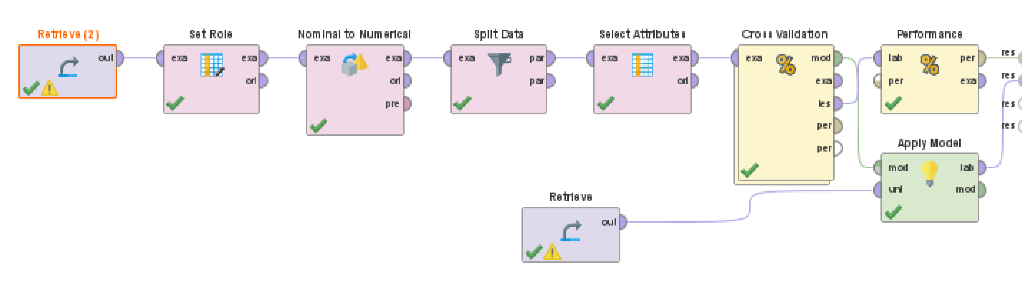
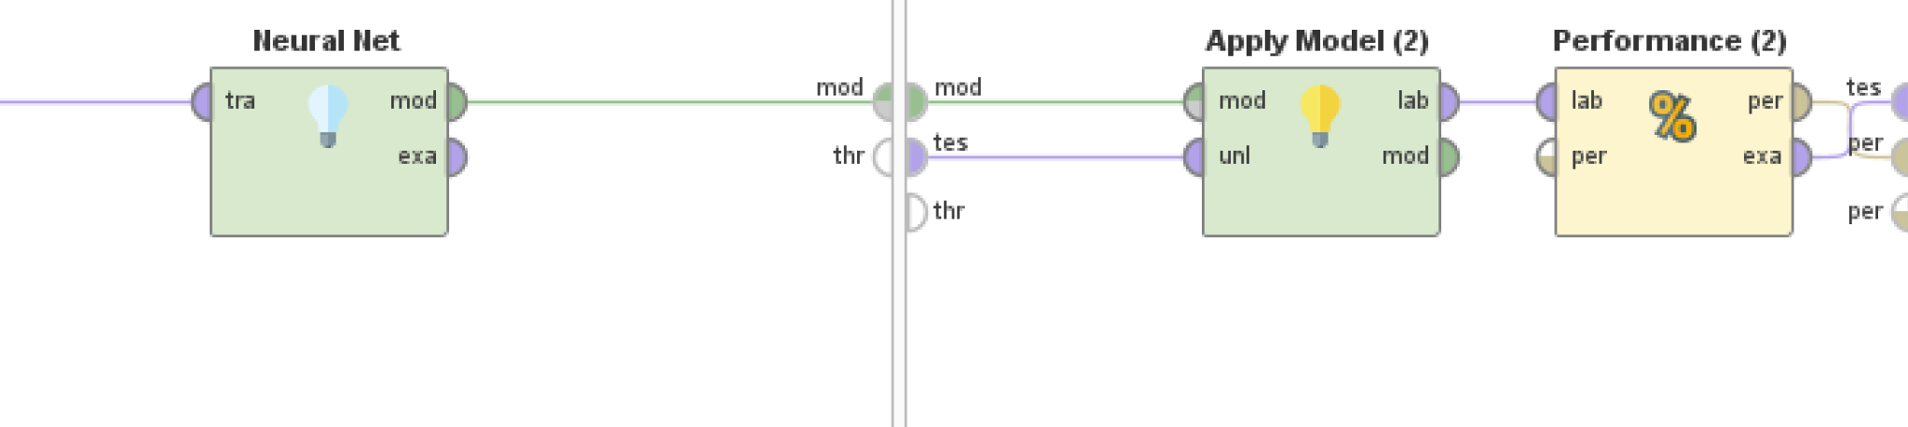
Shivangi Bhavsar
Neural Net
On testing the model for phase 3 to achieve 50-50 in the decision tree i got the accuracy level of 90.17% where for neural net i got 94.15 % accuracy level though i achieved 50-50 ratio in both .
The training and testing data was taken on 4:6 ratio .

Slide 12
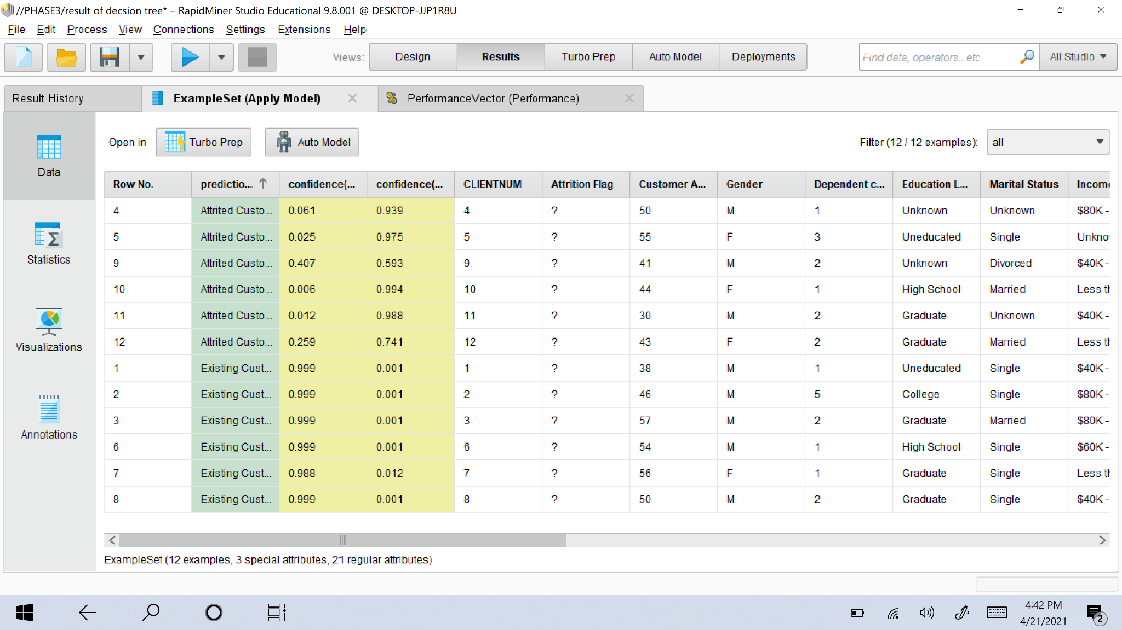
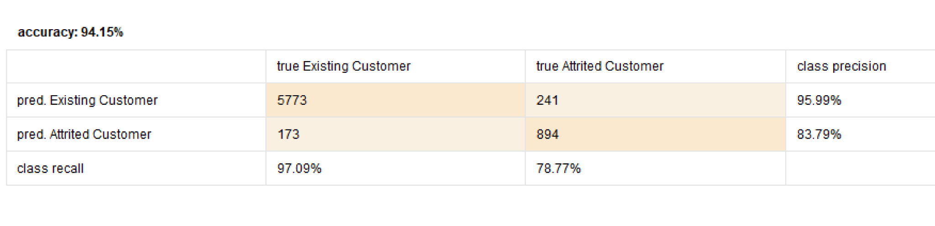
Result set -Neural net model
Shivangi Bhavsar
Neural networks are usually used to model complex relationships between inputs and outputs or to find patterns in data.
The 50-50 ratio has achieved with neural net model .

Slide 13
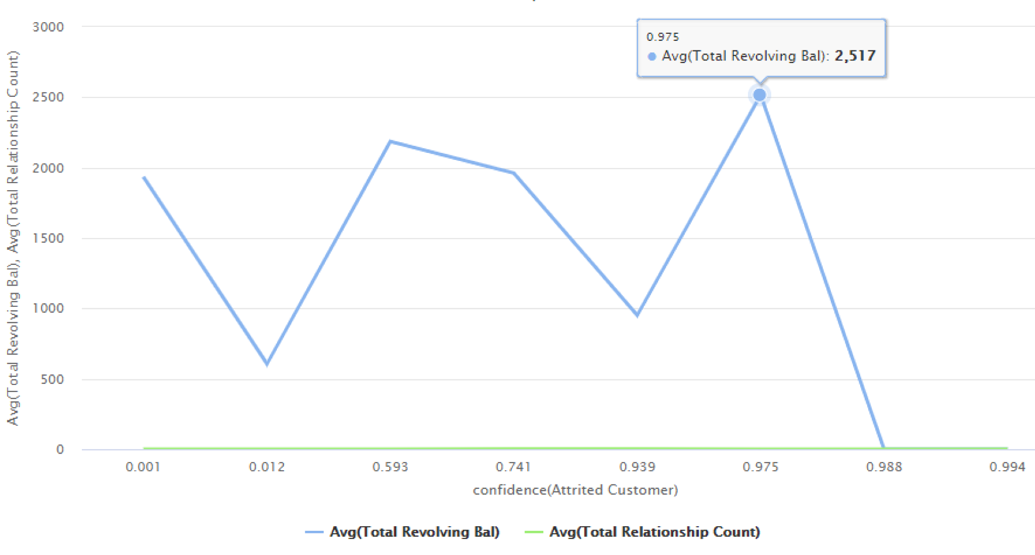
Attrited customer behavior
Shivangi Bhavsar
At confidence level of .975 the avg revolving balance for churned custom is 2517 where the relationship count is between 4 to 6 among all 6 churned customer .
Such observation help to understand the common significant behavior among the likely
churned customers .

Slide 14
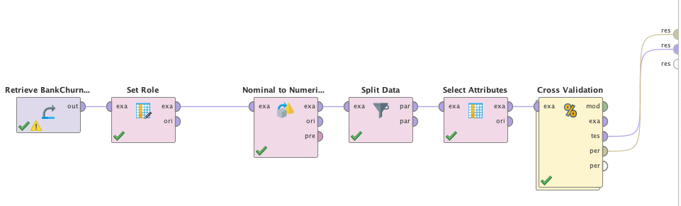
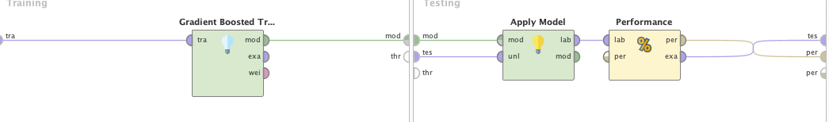
Training the Model For Prediction
Shreya Chauhan
Gradient Boosted Trees
For testing the model to achieve 50-50 ratio of Attrited and Existing customer, I choose the accuracy level of Gradient Boosted Model. I got high Accuracy and confidence with this model, the confidence level was high.

Slide 15
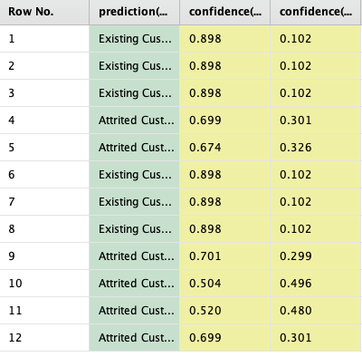
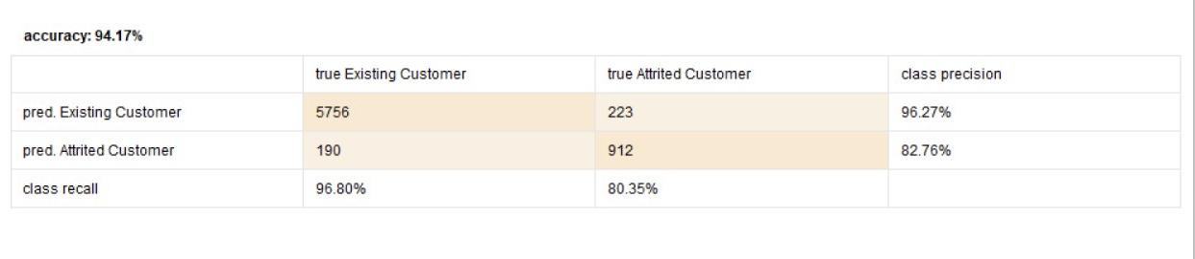
Shreya Chauhan
The 6/6 ratio is achieved using the adjusted attributes
The accuracy remains on the higher on comparison 94.17
The Gradient Boosted trees performs better than any model used for prediction as explained in the previous slide

Slide 16
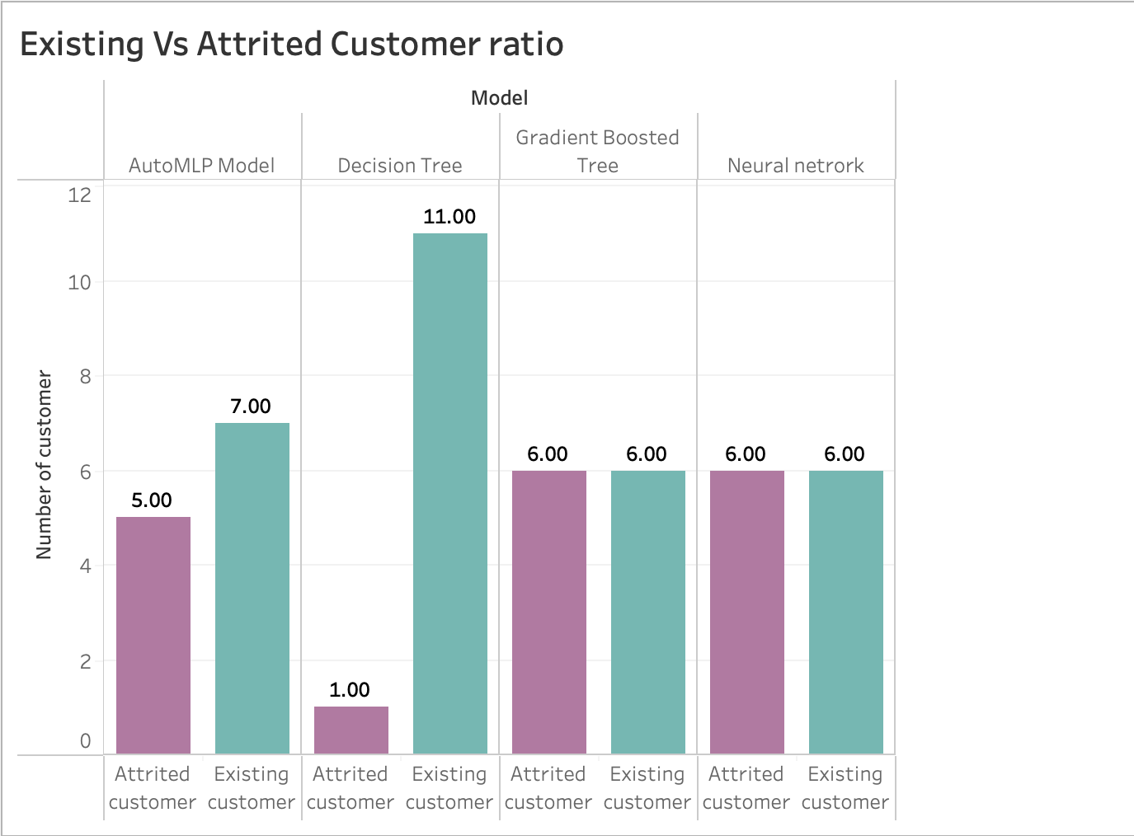
Shreya Chauhan

Slide 17
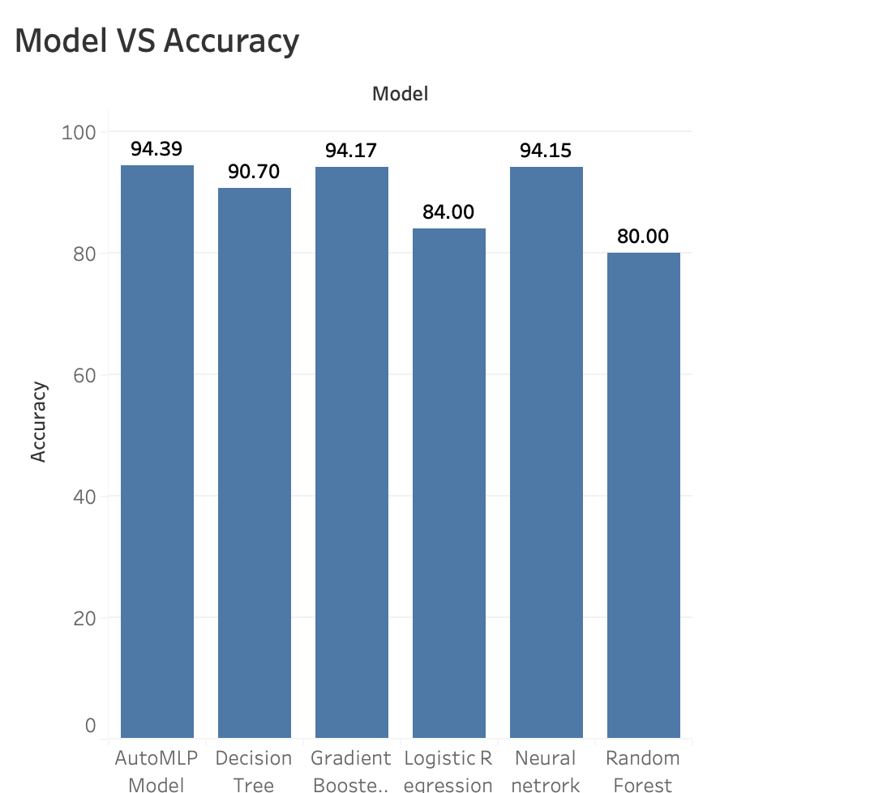
Accuracy with different Models
Shreya chauhan

Slide 18
CONCLUSION
MOHAMMED ZEESHAN ALI
Based on the requirements of the phase with respect to the ratio , accuracy and attributes “Gradient Boosted Trees” stands out as the best model.
The Ratio of 50/50 was achieved with GBT with a better accuracy in comparison to Neural Net which had an accuracy of 94.15%.

